Slide 1
The Future of Libraries is social
Authors-to-readers
Authors-to-readers
Authors-to-readers

Slide 2
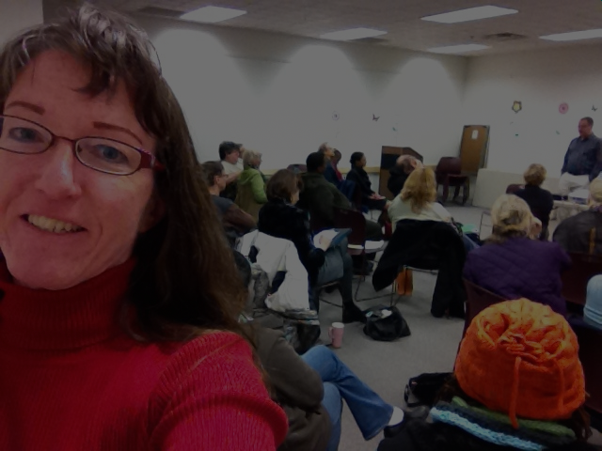
What Libraries are
Sharing Information
Communication Knowledge
Thoughts
Ideas
Gathering Place

Slide 3
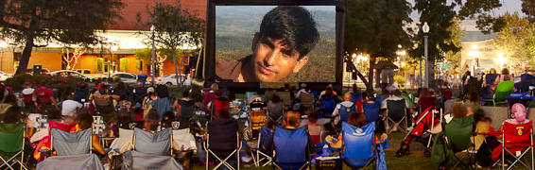
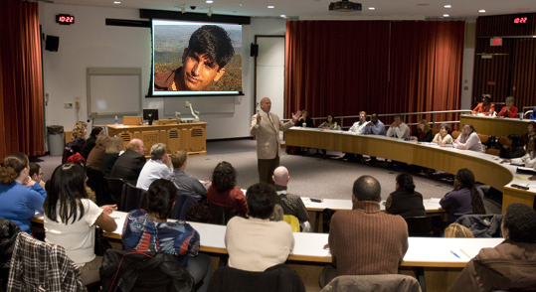

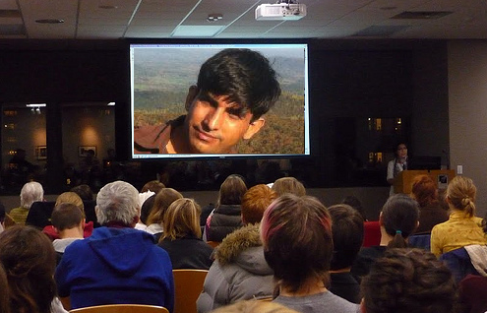
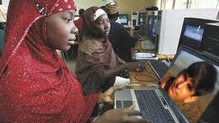
Online events at every library

Slide 4
Publishers are backcharging libraries
What other business keeps raising the price after the item is purchased?
Libraries aren't the Pentagon

Slide 5
People-to-People library
Everyone has a story to tell
Everyone is an ambassador for something
Grassroots effort by The PEOPLE
  don't need The Man to tell us to do it
The WOMAN

Slide 6
'Shareware'
Books
Libraries don't have to rely on funding for books
The community supports and develops the libraries
Libraries' role in society is not changing, but the way they carry out that role is
In exchange for: Gathering People
Free Review-licenses for checking out books
(free samples)

Slide 7
The Future of Books
Reading will become more social
      Not just broadcast on social media, but participatory
The line between 'books' and other forms of media will blur

